Slide 1

Algorithms
Lesson 4: Cholera in Soho

Slide 2
Objectives
In this lesson, you will learn how to:
use decomposition and abstraction to gain an understanding of a real-world problem
apply pattern recognition to identify the cause of a real-world problem and understand how it can be solved
analyse different approaches to solving problems.

Slide 3
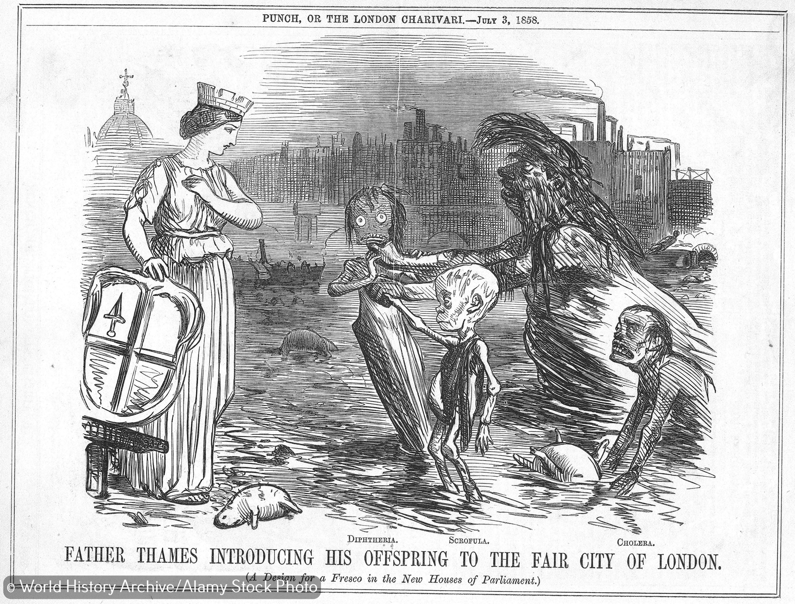
The Soho cholera outbreak of 1854
Covid-19 has had a big impact on our lives since the beginning of 2020, but the experience of battling disease is not new and we have overcome serious health crises in the past.
In 1854, the Soho district of London was being ravaged by cholera. Hundreds of people were already dead and more were dying every day.
Bacteria had not yet been identified as the cause of cholera. A commonly held view was that it was ‘miasma’, foul-smelling air, possibly from the highly polluted River Thames, that spread the disease.

Slide 4
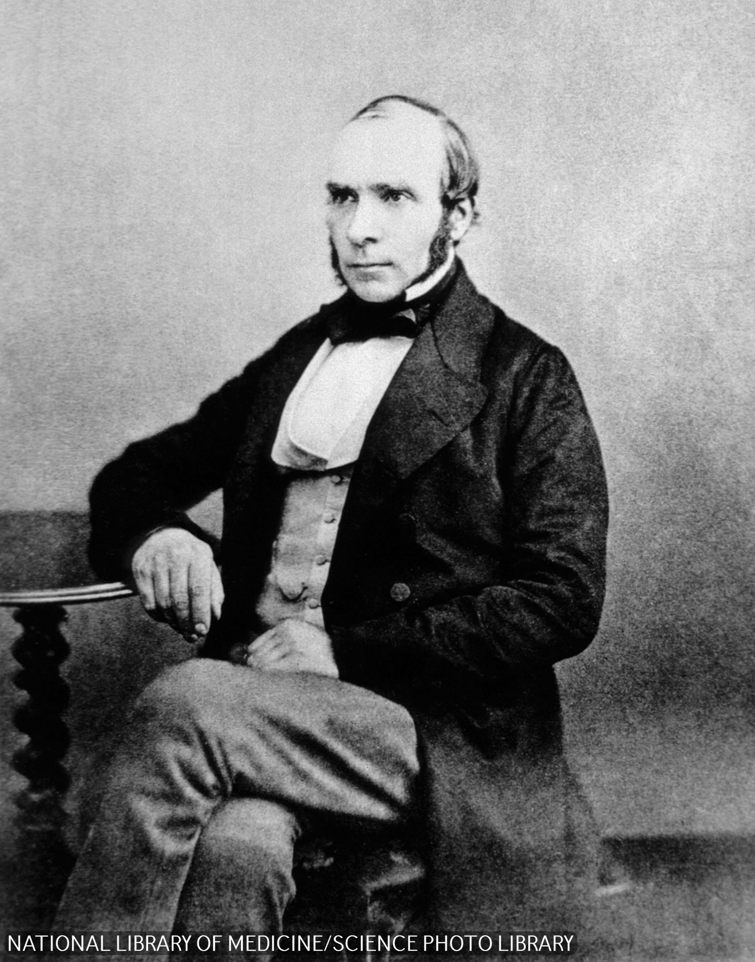
Dr John Snow
This was the challenge facing Dr John Snow.
He did not accept the miasma theory and set about proving that something else was causing the spread of cholera in Soho.
Although the term was not used at the time, Dr Snow applied some of the principles of computational thinking as he set about working out what was killing people.

Slide 5
Understanding the problem
Dr Snow's first goal was to understand the outbreak.
He began by applying decomposition and pattern recognition, asking questions and gathering as much data as he could and examining it for patterns.
Here are some of the vital clues Dr Snow collected:
Brewery workers rarely caught cholera. They did not drink water, preferring to drink the free beer available to them.
A workhouse near Soho had 535 inmates but almost no cases of cholera. The workhouse had its own well.
Two women living some distance from Soho died of cholera. They had water from the Broad Street pump in Soho brough to them regularly.
Hundreds of people contracted cholera after spending time in schools, restaurants, businesses and pubs near the Broad Street pump.

Slide 6
Collecting data
Dr Snow also compiled a detailed ‘spot map’ to record the locations where people died of cholera.
The map is an abstraction of the cholera outbreak. Each bar drawn on the map represents a person who died.
Without lots of personal information about each person, Dr Snow was able to recognise patterns in the locations of infected people.

Slide 7
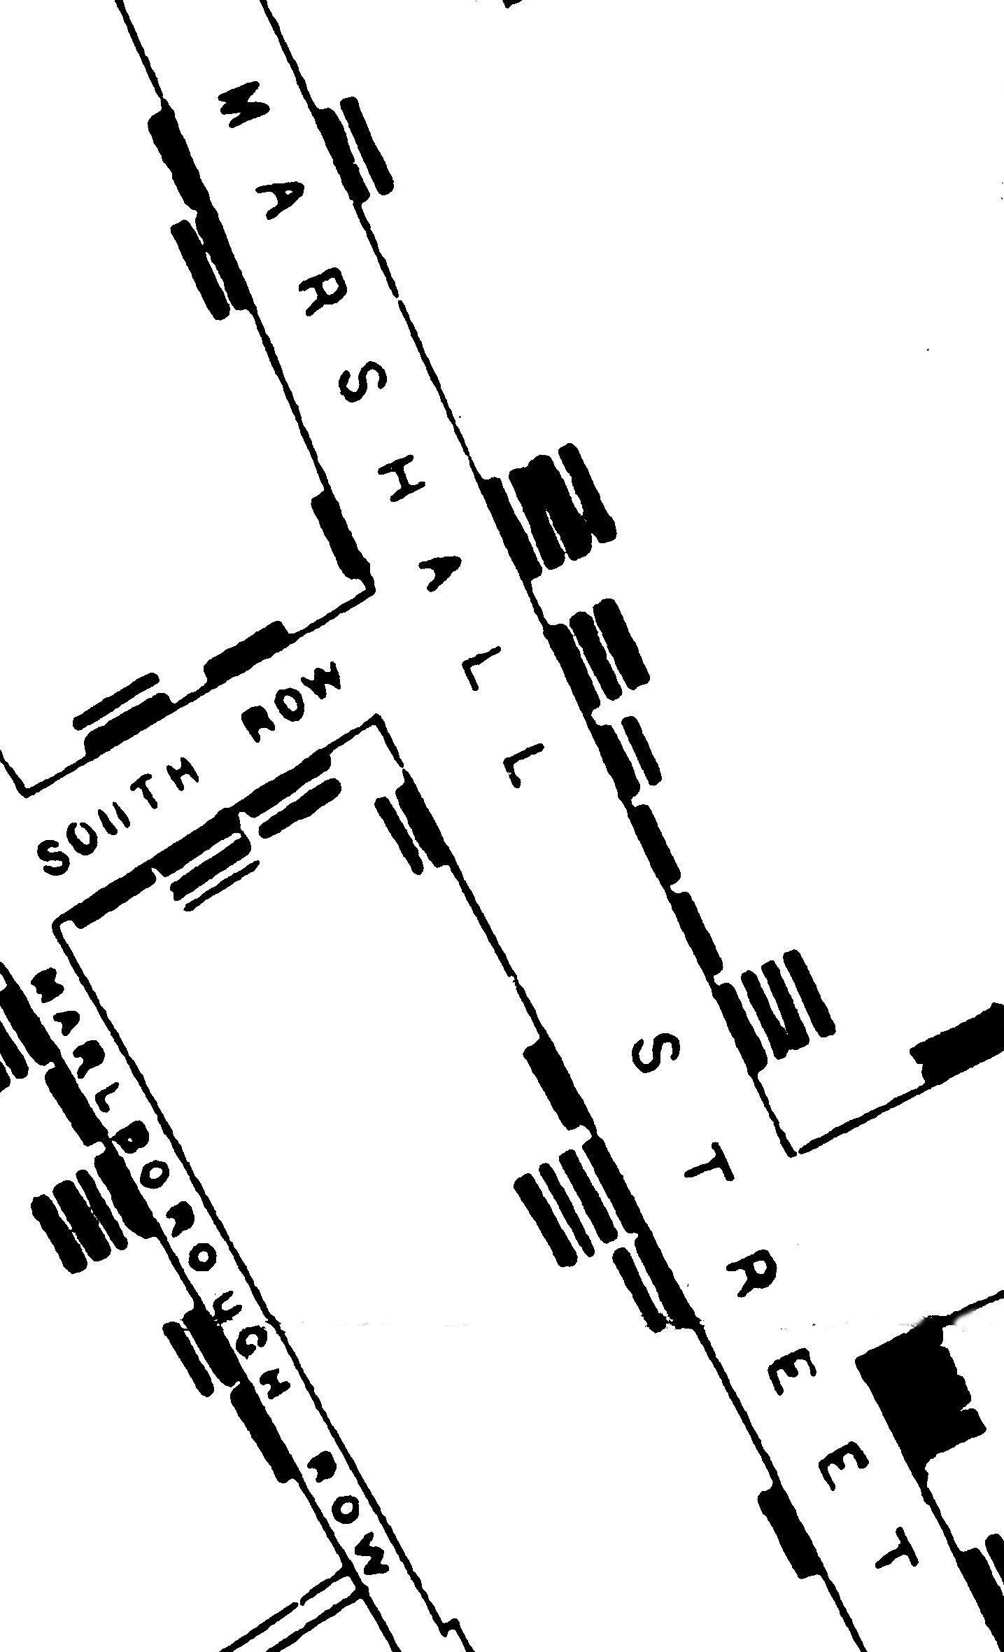
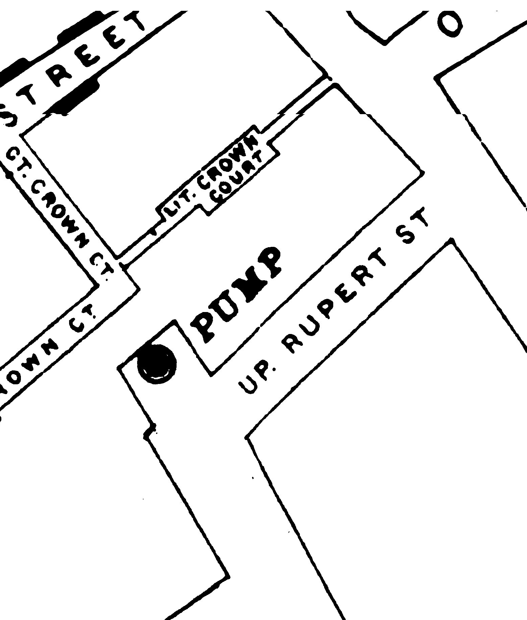
Here are two sections of Dr Snow's map:
Each bar represents a person who died of cholera. Some houses on Marshall Street have no bars; no one died in these houses. Some houses have four bars.
If we count all the bars that run parallel to the road, we can see that at least 31 people died in the portion of Marshall Street shown here.
Dr Snow's map also recorded the locations of the drinking water pumps, where people collected water. People did not have taps in their houses.

Slide 8

Activity 4.1: Dr Snow's cholera map

Slide 9
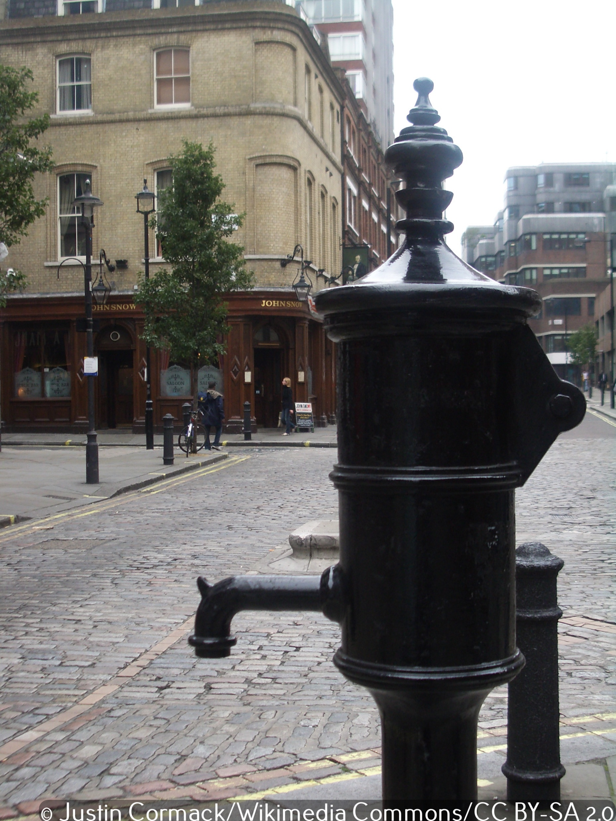
The well beneath the Broad Street pump and 40 Broad Street
Further detective work to identify the cause of the cholera found that a cesspit filled with toilet waste, below 40 Broad Street, was leaking into the well that the Broad Street pump drew water from.
A child living at 40 Broad Street died of cholera two days before the outbreak. The child’s mother had been disposing of the child’s toilet waste into the cesspit. This was the cause of the infected pump water.

Slide 10
Dr Snow and epidemiology
Dr Snow saved many lives in Soho, but his greater contribution to medicine is the algorithm he invented. He is considered to be the ‘father of epidemiology’.
Epidemiology is the study of the distribution (who, when and where) and causes of health and disease in defined populations. The computational-thinking approach to tackling disease outbreaks that Dr Snow invented can be seen in epidemiologists' important role in responding to Covid-19.

Slide 11
Activity 4.2: Dr Snow's algorithm

Slide 12
Activity 4.2: Dr Snow’s algorithm
Here are some hints to help you with the activity, in no particular order.
Test hypothesis
Is the hypothesis correct?
Look for patterns
Implement treatment
Come up with a hypothesis
Identify infected people
Collect data

Slide 13
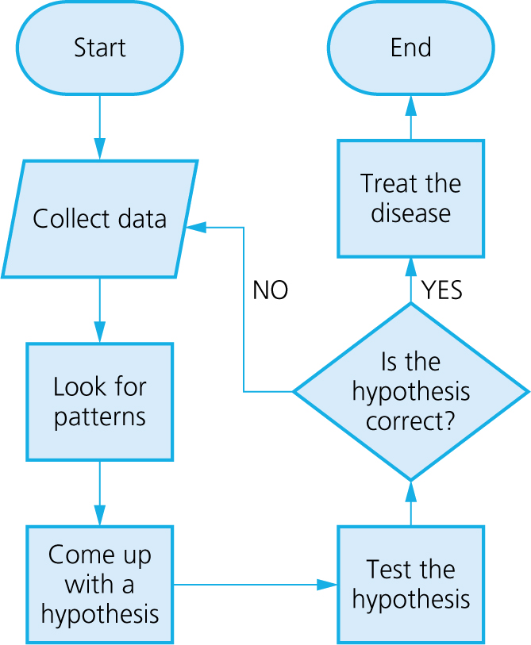
Activity 4.2: Dr Snow’s algorithm
Here is one possible solution:

Slide 14
Generalisation
Dr Snow's algorithm is still relevant today.
When a solution to a problem – like Dr Snow's algorithm – is applied to many similar types of problems, this is known as generalisation and it is a key technique used in computing.
Computer programmers frequently borrow and adapt code written for a different but similar purpose. Generalisation makes coding much more efficient and improves productivity.

Slide 15
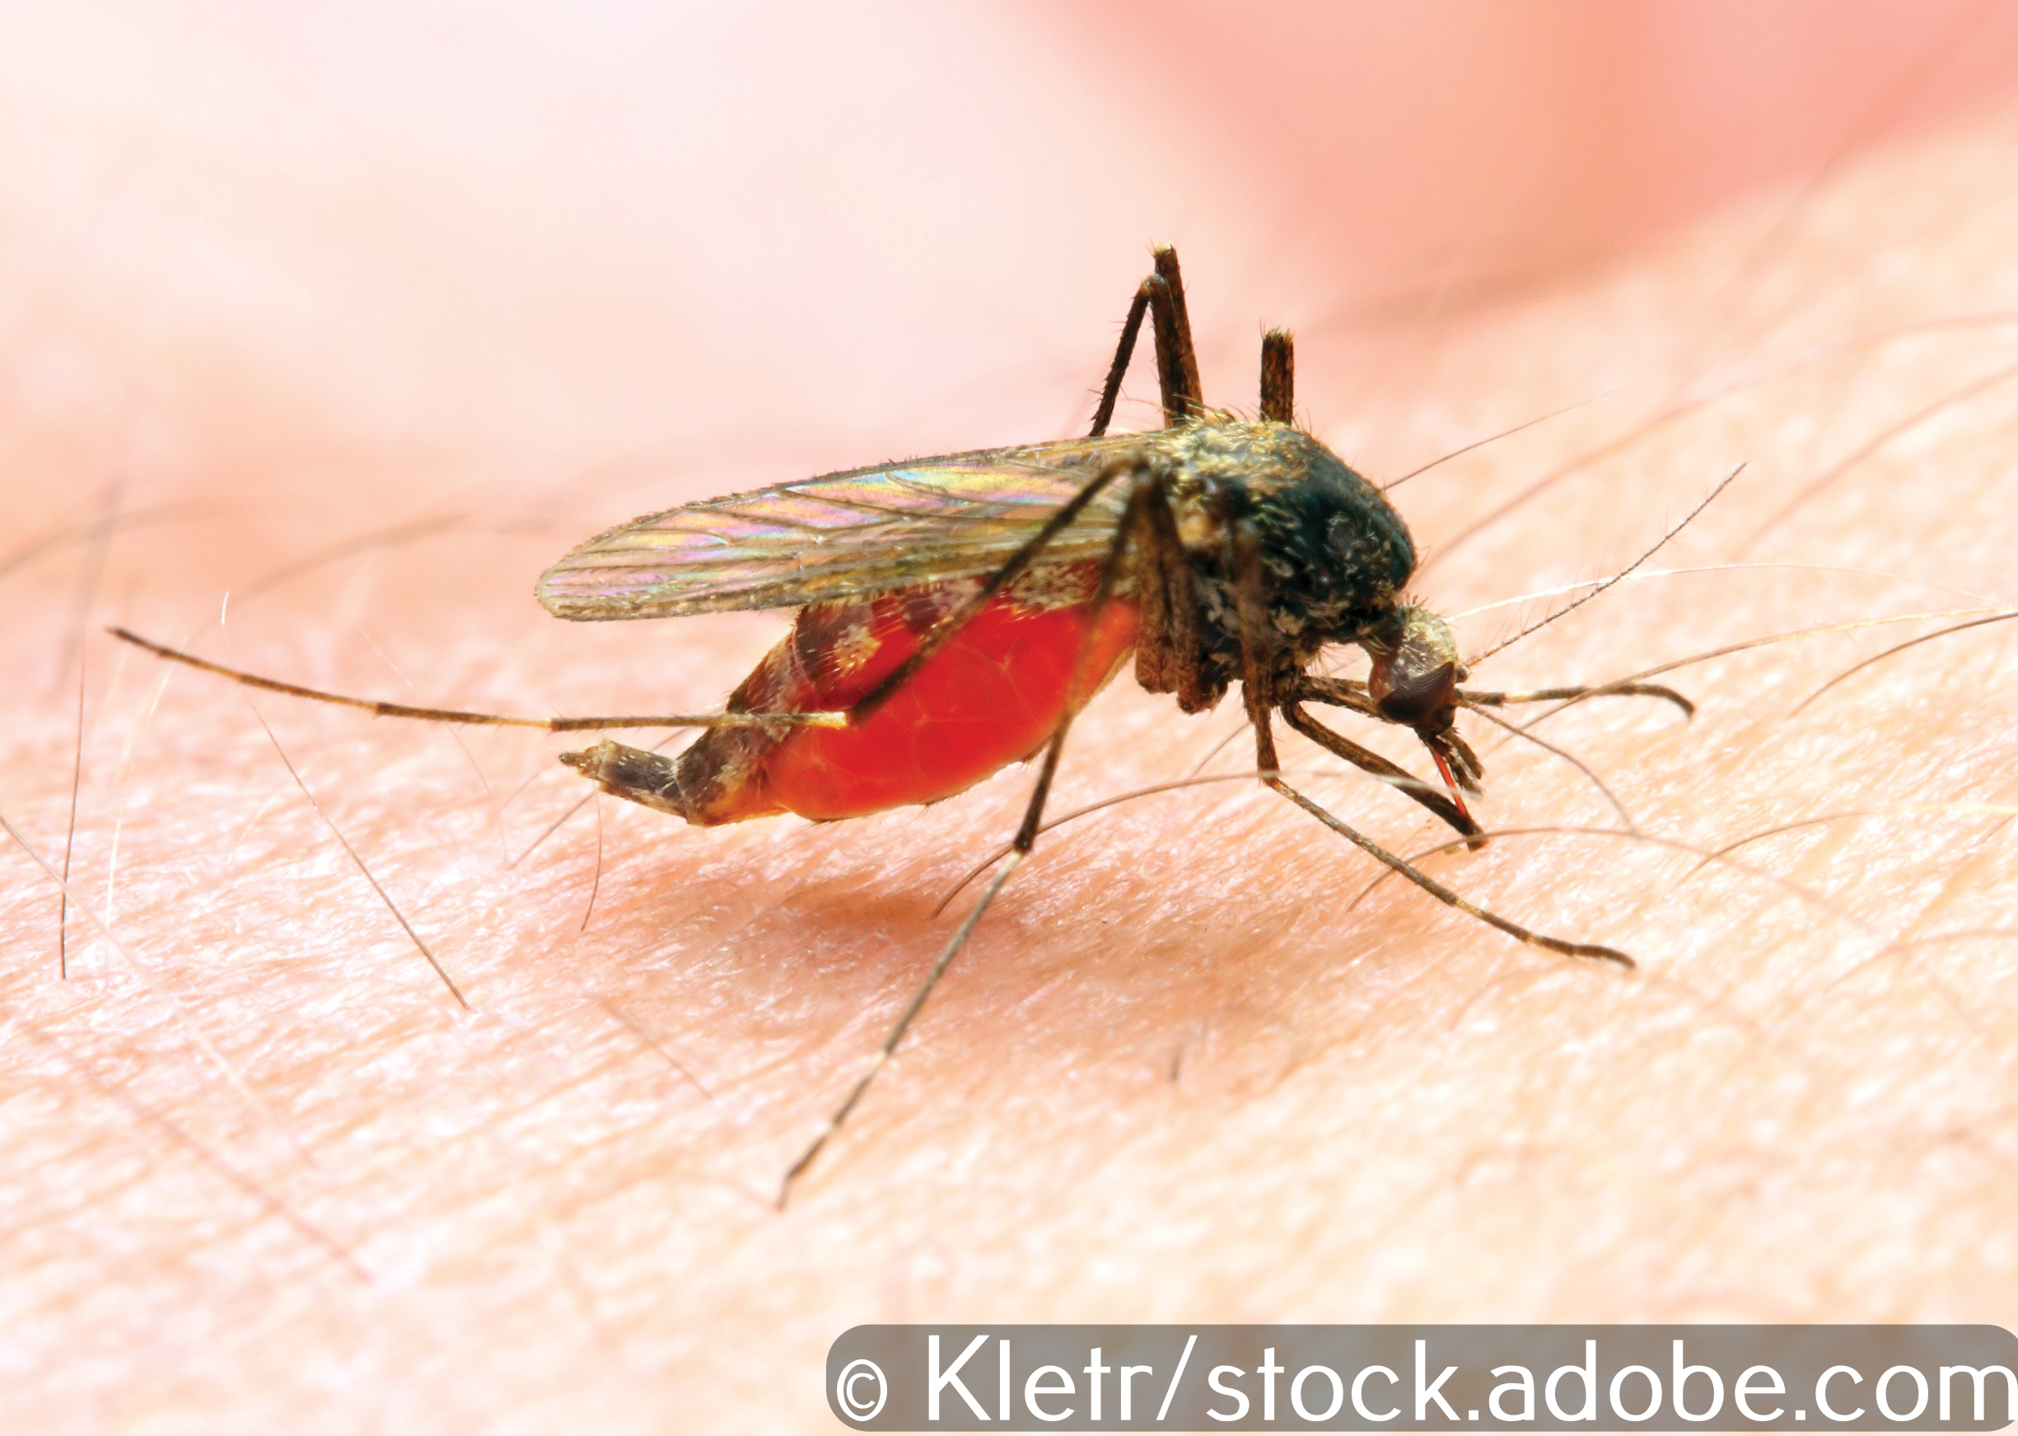

East African News
Malaria is the deadliest disease on Earth. It is spread by the Anopheles mosquito and kills millions of people every year.
The most effective way of preventing malaria is to destroy the mosquito in its breeding grounds by spraying them with insecticide, but insecticides are expensive and polluting. Mosquito nets can stop people being bitten in the first place, but not everyone uses them.

Slide 16
Quiz 4

